Slide 1
Multimodal Adaptive Social Interaction in Virtual Environment (MASIVR) for children with Autism Spectrum Disorders (ASD)
IEEE VR 2016

Slide 2
Introduction
1. Atypical patterns of behavior, communication and social interaction impairments are characteristics of autism spectrum disorders (ASD).
2. However, the manifestation of these deficits is quite different from one individual to another, which calls for approaches to individualize the therapy as opposed to one-therapy-fits-all strategies.
3. Bauminger showed that children with ASD showed improved social functioning and understanding, when they recognized and displayed complex emotional expressions.
4. Virtual reality environments offer benefits to children with ASD mainly due to their ability to simulate real world scenarios in a carefully controlled and safe environment.

Slide 3
Introduction
5. Existing VR-based systems do not incorporate implicit cues from sensors such as electrophysiological signals including peripheral physiological signals and electroencephalography (EEG), and eye tracking within the VR environment.
6. In this paper, we present the design, development and a usability study based evaluation of the novel Multimodal Adaptive Social Interaction in VR (MASI-VR).

Slide 4
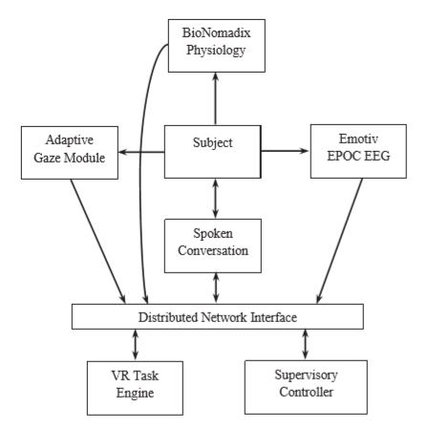

Slide 5
System Design
1. The MASI-VR task presentation engine
(1) Characters
(a) Characters were customized and rigged in online animation and rigging service, mixamo (www.mixamo.com), and Autodesk Maya (www.autodesk.com).
(b) A total of 7 characters including 4 boys and 3 girls were selected and customized for the embedded facial expression display and another set of 12 characters for primary social interaction.
(c) Facial emotional expressions (enjoyment, surprise, contempt, sadness, fear, disgust, and anger) had 4 arousal levels (low, medium, high, and extreme).
(d) Seven phonetic viseme poses (L, E, M, A, U, O, and I) were created for speech animation.

Slide 6
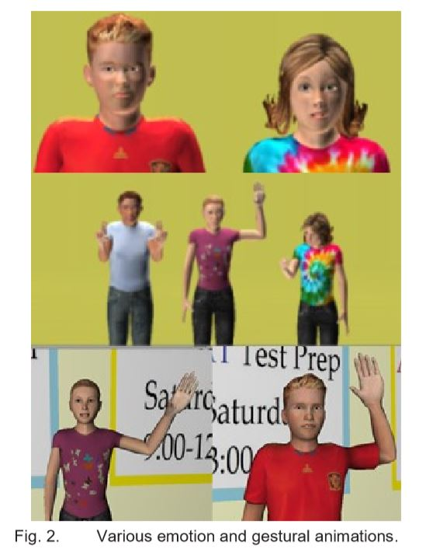

Slide 7
System Design
1. The MASI-VR task presentation engine
(2) The VR Environment
(a) Unity for VR task presentation engine.
(b) BioNomadix physiological signals acquisition device for peripheral psychophysiological monitoring.
(c) Tobii X120 remote desktop eye tracker by for eye tracker.
(d) The venue for the social interaction task is a virtual school cafeteria.

Slide 8
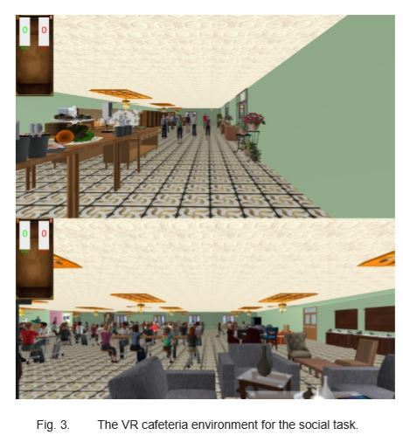

Slide 9
System Design
2. The Dialog Management System
(1) The speech interface module was developed using the Microsoft Speech API (MS SAPI) SDK for domain dependent conversation.
3. EEG Monitoring Module
(1) Emotive EPOC neuroheadset collected 14 channels of signals (AF3, F7, F3, FC5, T7, P7, O1, O2, P8, T8, FC6, F4, F8, and AF4).
(2) Six EEG features
(a) Theta band (4-8Hz) power at right parietal (右顶骨) area (P8).
(b) Averaged theta2 band (6-8Hz) power at left anterior (左前侧) areas (AF3, F7, F3, and FC5)
(c) Averaged alpha2 band (10-12Hz) power at anterior areas (AF3, F7, F3, FC5, FC6, F4, F8, and AF4)

Slide 10
System Design
3. EEG Monitoring Module
(2) Six EEG features
(d) Alpha2 band (10-12Hz) power at right parietal (右顶骨) area.
(e) Averaged beta1 band (12-18Hz) power at anterior areas.
(f) Gamma band (30-45Hz) power at right parietal area.

Slide 11
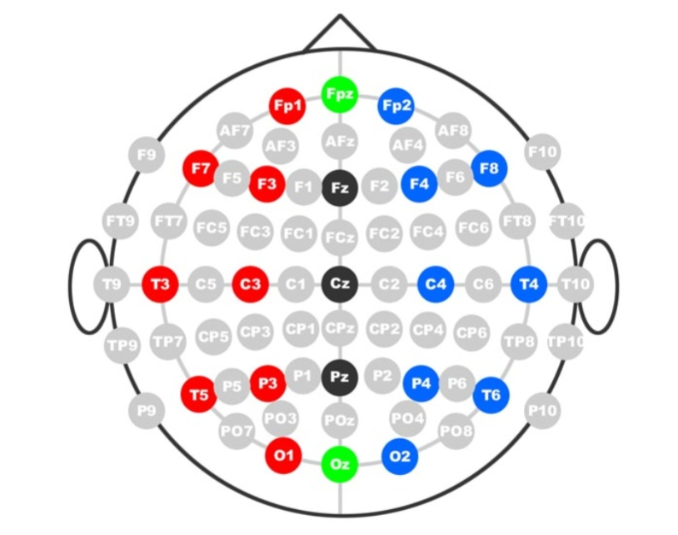
国际脑电图学会的10-20标准电极位置

Slide 12
System Design
4. Eye Gaze Monitoring and Online Adaptation
(1) The defined ROIs represented the following regions: forehead, eyes (left and right), nose, and mouth.
(2) Raw data:
(a) Average fixation duration (FDave)
(b) Sum of fixation counts (SFC)
(c) Blink rate (BR)
(d) Pupil diameter (PD)

Slide 13
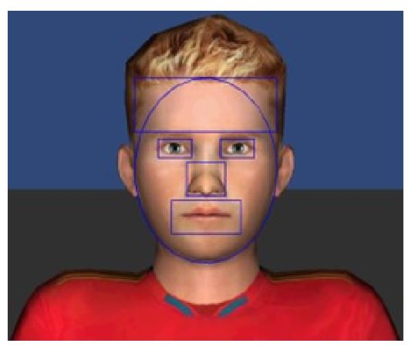

Slide 14
Methods and Procedure
1. Procedure
(1) Pre-test.
(a) For the first 25-40 s, the character narrated a lip-synced context story.
(b) Subjects were expected to rate the emotions based on the last 5 seconds of interaction.
(c) A total of 28 trials corresponding to the 7 emotional expressions with each expression having 4 levels.
(2) NEuroPSYchological (NEPSY) Assessment.
(3) 3 conversation paradigms with emotions at high, medium and low valence.
(a) At the start of the social task, the subject will go through a sequence of instructions on how to perform the task.
(b) Subject gets to move around the virtual cafeteria and approach a character to interact with.

Slide 15
Methods and Procedure
1. Procedure
(3) 3 conversation paradigms with emotions at high, medium and low valence.
(c) The subject can choose missions (12 conversational dialog missions in total) and conversational topic.
(d) At the end of each dialog mission facial expressions were presented with the face occluded with oval occlusion and subject gets to choose what the emotion was.
(4) Post-test (same as Pre-test).
(5) NEuroPSYchological (NEPSY) Assessment.

Slide 16
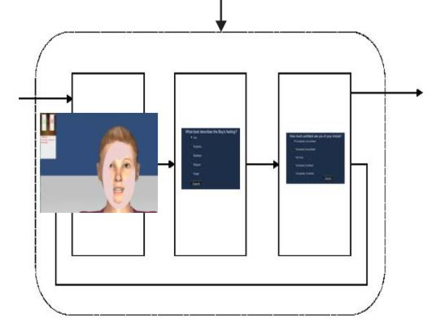

Slide 17
Methods and Procedure
2. Subjects
(1) 6 in gaze group and 6 in control group.
(2) All subjects were recruited through existing clinical research programs and were diagnosed with Autism Diagnostic Observation Schedule (ADOS).
(3) The control group were trained using the system without any online gaze feedback and without the occlusion paradigm.

Slide 18
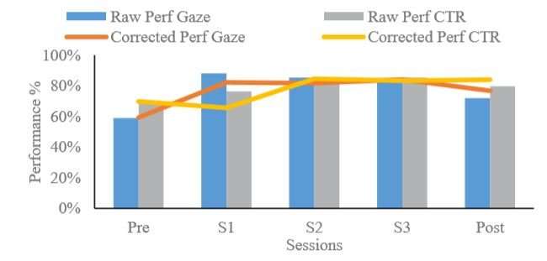
Results
1. Both the gaze and the control group were able to improve their performance from pre to post while the gaze group improves by 3% more than the control group’s improvement.

Slide 19
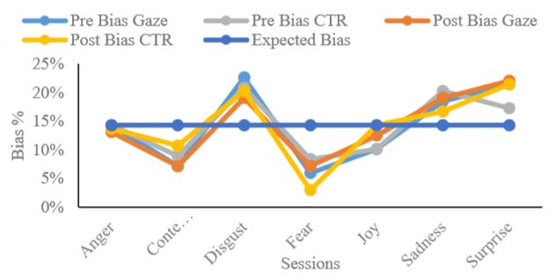
Results
2. Subjects were more biased for some emotions such as fear over the others.

Slide 20
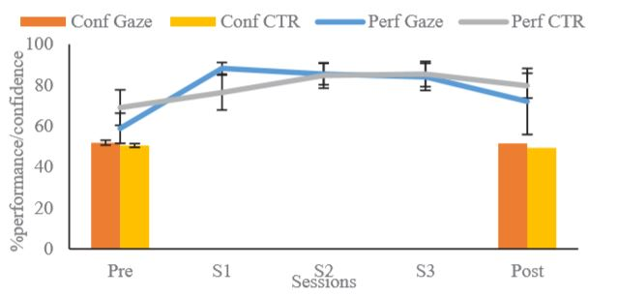
Results
3. There was no significant difference in confidence between gaze group and the control group.

Slide 21
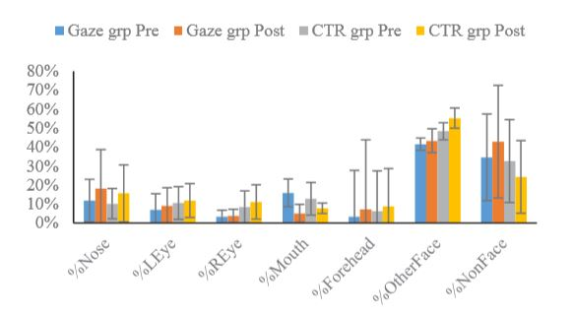
Results
4. Both groups increased in the eyes, forehead and nose ROIs.
5. The gaze group increase in the comboFace (nose + forehead + eyes) was specifically larger than the control group.

Slide 22
Results
6. The gaze group increased their gaze towards the eyes with a more symmetric gaze in the post test (bottom) than the pre-test.
7. The control group also had a more symmetric and slightly increased gaze towards the eyes in the pre-test than the gaze group.

Slide 23
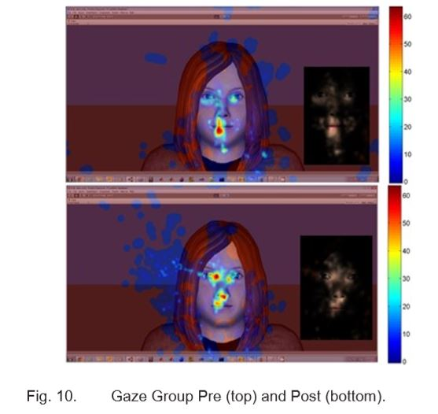
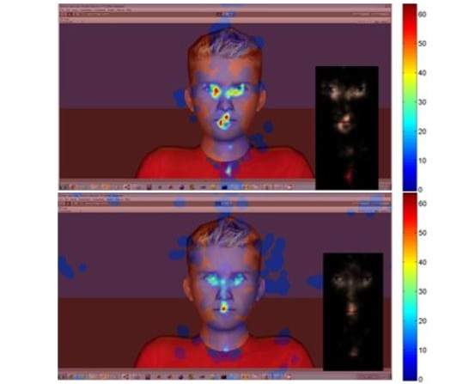
Control group
Gaze group

Slide 24
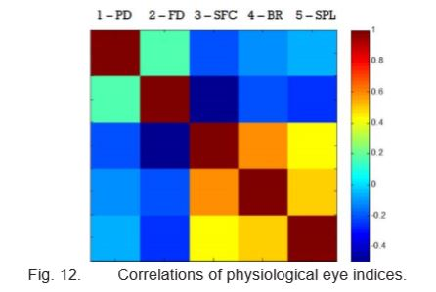
Results
8. Features 3, 4, and 5 are highly correlated and the three features are inversely correlated with FD.
The pupil diameter (PD), the fixation duration (FD), sum of fixation counts (SFC), blink rate (BR), and saccade path length (SPL).

Slide 25
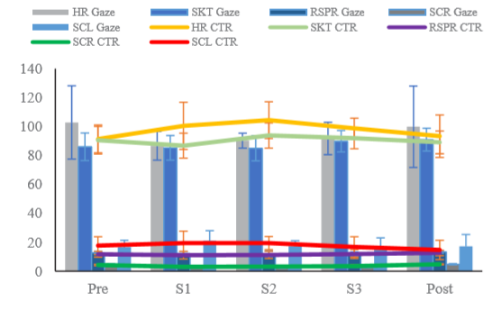
Results
9. None of these changes of physiological data were statistically significant.
The heart rate (HR), the skin temperature (SKT), the respiration rate (RSPR), the galvanic skin conductance rate (SCR), and the skin conductance level (SCL).

Slide 26
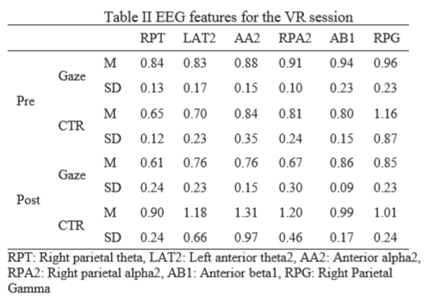
Results
10. For gaze group, the values of all the features decreased. For control group, all but right parietal gamma (RPG) increased.

Slide 27
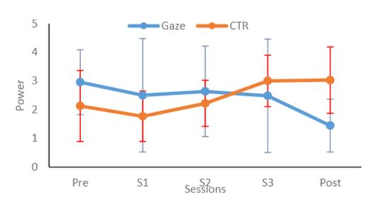
Results
11. The gaze group decreased engagement from pre to post-test although the change was not as significant.

Slide 28
Discussion
1. The gaze group subjects had difficulty in understanding the occlusion paradigm at first as explicit guidance was not given.
2. The gaze-sensitive system enabled the gaze group to close the performance gap that existed in the pre-test with the control group by more than 3% points.

Slide 29
Conclusion
1. The system proved that the controllability, ease of interaction without information overload and the game nature of the interaction were useful in training core deficit areas of children with ASD for eventual better social functioning.
2. These preliminary findings will be used to build a more robust adaptive VR-based social interactive environment for children with ASD to improve their emotion recognition abilities and eventual social functioning.

Slide 30
Project Butterﬂy: Synergizing Immersive Virtual Reality with Actuated Soft Exosuit for Upper-Extremity Rehabilitation
IEEE VR 2019

Slide 31
Introduction
1. Older adults (deﬁned as people aged 65 years old or older) living in the US comprise 13 percent of the US population.
2. In addition to the decline in motor function, aging correlates to the progressive loss of skeletal muscle mass and strength.
3. Drawbacks of traditional method derived from therapists’ observation and judgment are that they are often inaccurate, expensive, and timely.
4. Virtual reality is a useful tool for improving outcomes compared to conventional therapy by enabling accurate motion capture, telepresence based sessions, and low cost motivating experiences.

Slide 32
Introduction
5. Through combining VR with exoskeletons that provide arm gravity support, clinical testing showed a range in improvement of mobility, strength, and satisfaction.
6. This study aims to leverage such soft exosuits during VR therapy through the use of Compliant Robotic Upper-Extremity Exosuit(CRUX) to explore feasibility, ease-of-use, and comfort.

Slide 33
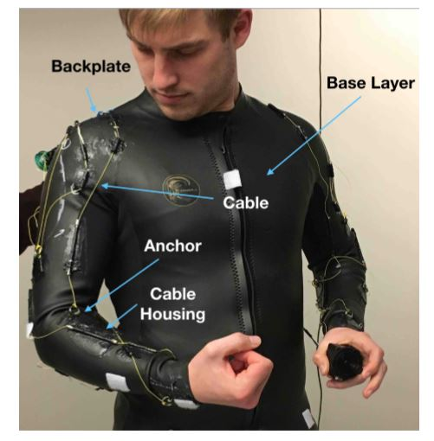
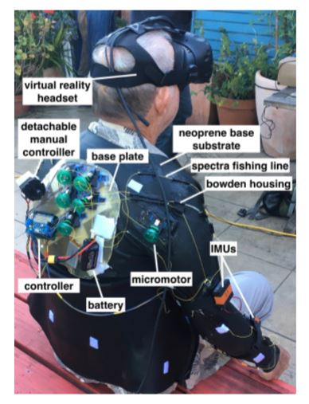

Slide 34
System Design
1. Project Butterfly (PBF), is a game that motivates users to perform upper body motion primitives by having them protect a virtual butterfly in a meadow while the system collects real-time data using the HTC Vive.
2. These mechanics required the users to smoothly follow the flight of the butterfly within +/- 0.1m of the required motion path.
3. To generate the environment and the mechanics of PBF, the Unity v2017.1.0b4 Game Engine along with the SteamVR Unity plugin v1.2.0 became the chosen development tools.
4. To enable the mimetic control of the healthy arm onto the weak limb, wireless connectivity capability was added to connect with the Inertial Measurement Unit (IMU) networks.

Slide 35
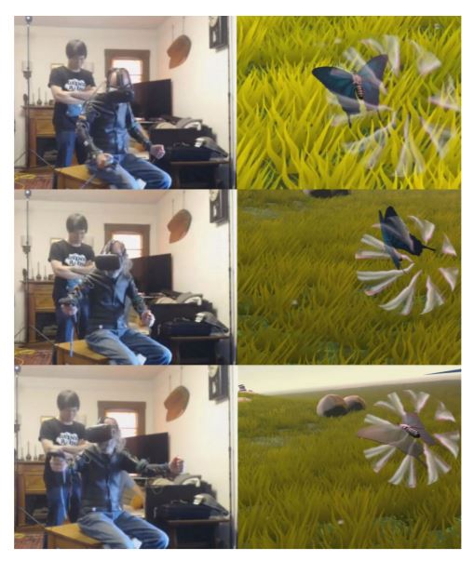

Slide 36
Usability Study
1. Participants
(1) Three retirees from Elderday Adult Day Health Care Center, Santa Cruz, CA, represented a mental disability.
(2) Three stroke survivors recruited from Cabrillo College’s Stroke and Disability Learning Center (SDLC), Capitola, CA, represented a physical disability.
(3) Three retirees living independently within their community, outside of daycare or hospice, which do not have a significant physical or mental disability.
(4) All participants ranged between the ages of 60 to 80 years old and were previously unfamiliar with both virtual reality and wearable robotics.

Slide 37
Usability Study
2. Procedure
(1) For each user, the evaluation began by an proctor giving a detailed explanation of what PBF and CRUX are, answering questions as needed.
(2) Then the user was given a tutorial consisted of playing two rounds of the biceps (二头肌) minigame and the lateral arm (侧腕) minigame for one minute each.
(3) After the tutorial period, the test commenced with the user playing game while wearing the CRUX exosuit.
(4) User evaluation interviews were executed by asking users questions pertained to their experience from a prepared form with questions.

Slide 38
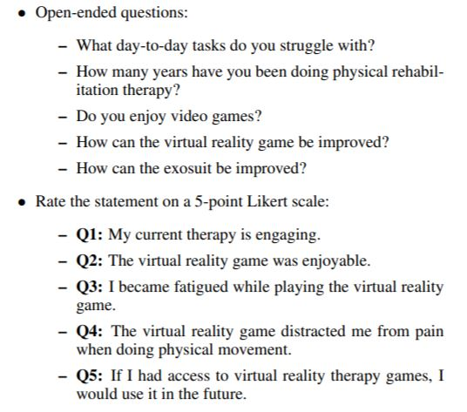

Slide 39
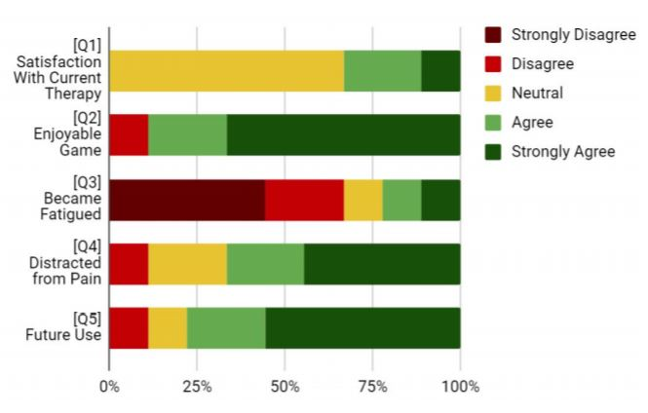
Results and Discussion
1. Most participants felt that CRUX augmented their upper limb movements to some degree.

Slide 40
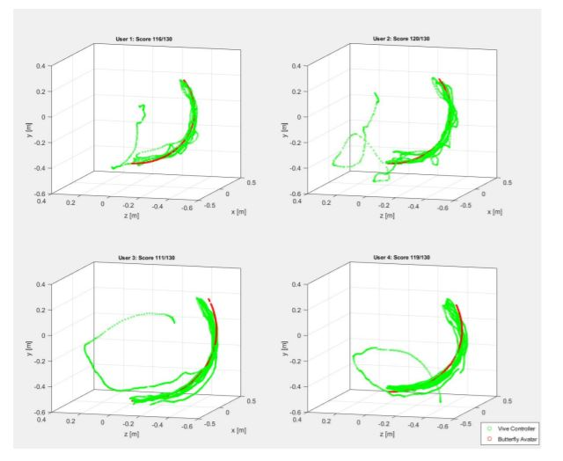
Results and Discussion
2. User 1 had sharp changes, User 2 had shaky movements, User 3 had smooth moves, and User 4 had smooth and shaky movements.

Slide 41
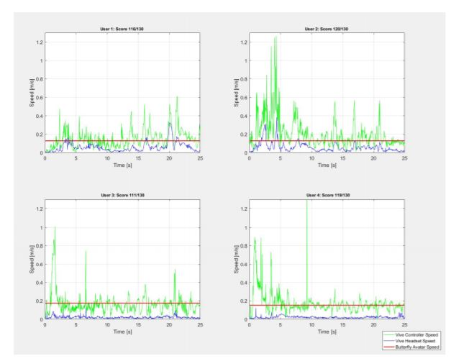
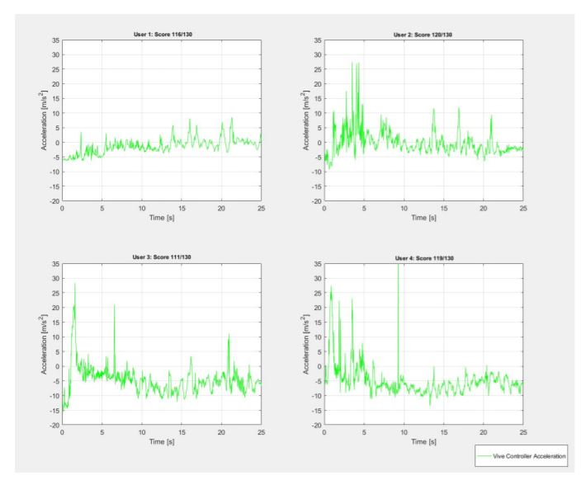
Results and Discussion
3. User 1 maintains the most control nearing almost no acceleration, followed by User 2 who spikes but nears zero, and Users 3 and 4 experienced occasional large shaking.

Slide 42
Limitation
1. One user thought that continuously protecting a butterfly would become boring for regular therapy.
2. Neoprene (氯丁橡胶) made CRUX hot when worn over an extended period.
3. Only three motion primitives were explored and converted into VR through PBF (lateral shoulder raise, forward arm raise, and horizontal shoulder rotation).
4. Furthermore, this study would benefit from a larger sample size of the users.

Slide 43
Conclusion
1. The system’s ease-of-use and comfort were analyzed, and most users felt that they were confident capitalizing on the therapy system.
2. An immersive physio-therapy VR game with an actuated soft robotic exosuit had promising results in the potential future of a more accessible, affordable, and personalized rehabilitation.

